Slide 1


TITLE : SMART ELECTRONIC
TROLLEY
Presented by
AMBIKA A S
DEPT. OF ECE, DBIT

Slide 2
Outline of the Presentation
Introduction Background Methodology Data and Analysis
Conclusions
Introduction
Background
Methodology
Data and Analysis
Results and Conclusion

Slide 3
Introduction
Background
Methodology
Data and Analysis
Conclusions
Introduction
Motivation
A smart trolley is a technological advanced transportation system designed to efficiently move goods,products or materials within various environments.
By equipping with advandaced technology,it can used by turning on the swtich to move forward and turn off the swtich to stop.
By combining convenience with modern tech features,smart trolleys aim to reduce the physical strain of carrying luggage ,enhance travel efficiency .

Slide 4
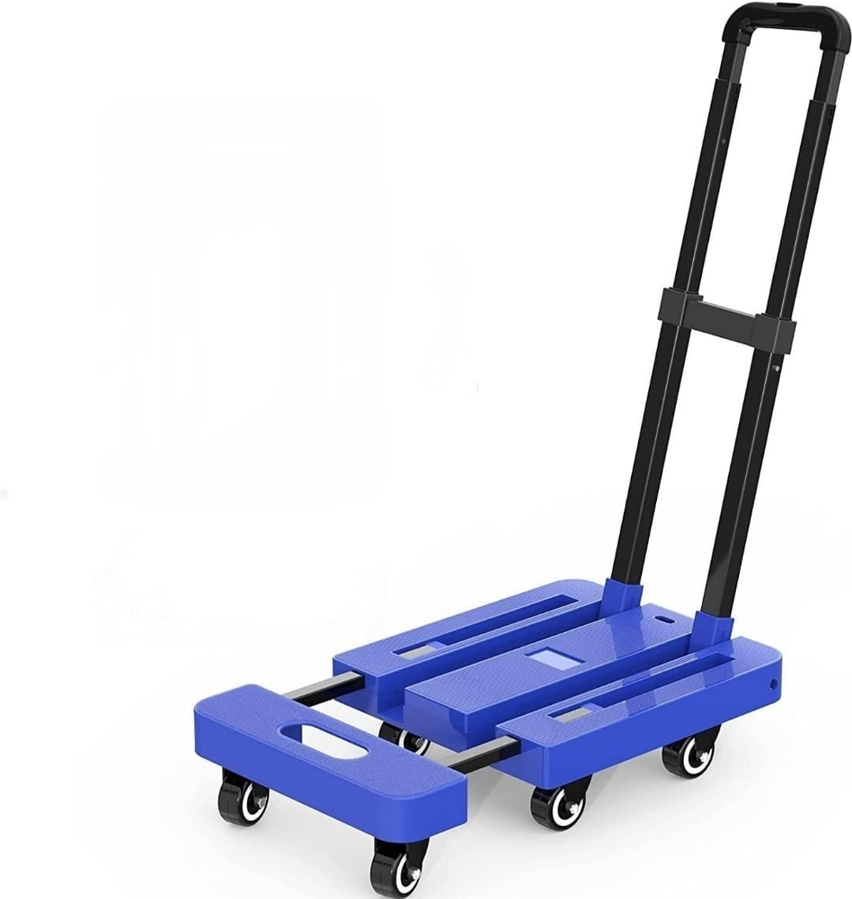
Introduction
Background
Methodology
Data and Analysis
Conclusions
People of today enjoy traveling to new places. There are usually always throngs of people traveling through airports.
One of the main travel inconveniences is the large luggage they are carrrying.
Airports must provide luggage trolleys in order to lessen this burden.
Most places you'll see these luggage carts are airports, sizable bus terminals, lodging facilities, or rail stations.
It does, however, take more work to traverse, particularly for elderly or disabled people.
This study's primary goal is to design a luggage cart that the owner may operate with a turning on or off the swtich .
When going on a business trip, taking a family holiday, or studying abroad, the plane is typically the main mode of transportation.

Slide 5
Introduction Background
Methodology
Data and Analysis
Conclusions
Background
History
1900s: Electric Streetcars.
1930s: Mechanical Warehouse Trolley
1960s: Automated Guided Vehicles.
1990s: Early Smart Technology

Slide 6
Introduction
Background
Methodology
Data and Analysis
Conclusions
Literature Review
Chang, H., et al. (2021). Design and Development of Smart Trolleys in Warehouse Logistics. Journal of Automation and Industrial Engineering, 14(2), 45-58.
Lee, K., et al. (2020). Intelligent Airport Trolleys: Applications and Challenges. International Journal of Airport Technology, 27(1), 11-23.
Patel, R., et al. (2022). Healthcare Applications of Smart Trolleys: A Review of Recent Advancements. Journal of Healthcare Robotics, 9(4), 88-101.
Zhang, T., et al. (2019). Challenges and Future Prospects of Smart Trolley Systems. Robotics and Autonomous Systems, 67, 85-99.

Slide 7
Methodology
Introduction Background Methodology Data and Analysis Conclusions
Battery: Lithium-ion rechargeable battery systems is used to power motors and swtich.
Motors: Motors for movement control, which can be either electric or battery-powered.
Trolley: A trolley is a wheeled cart used to transport heavy goods or items such as luggage,books.
Switch: It is used to turn on and off electrical devices.
Charger: It is used to charge the rechareable battery.

Slide 8
Introduction
Background
Methodology
Data and Analysis
Conclusions
MOTOR 5
MOTOR 1
MOTOR 6
MOTOR 2
TROLLEY
SWITCH
MOTOR 3
RECHARGEABLE BATTERY
MOTOR 4
CHARGER

Slide 9
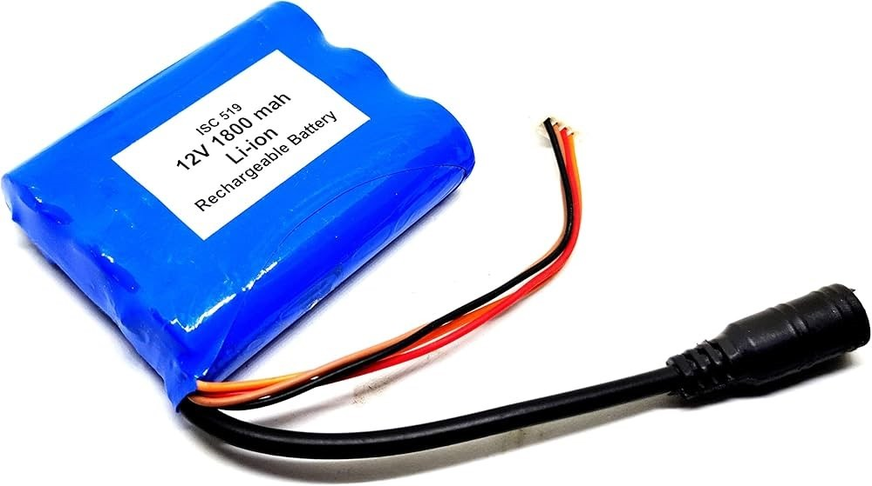
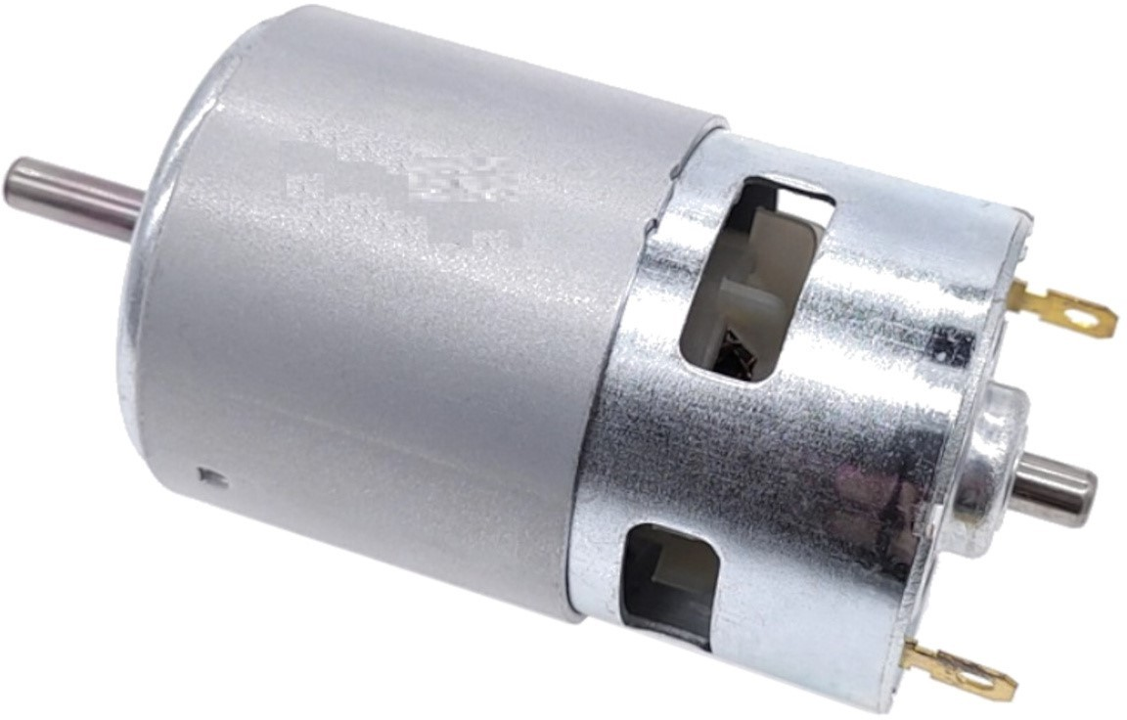
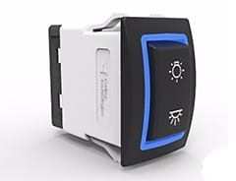
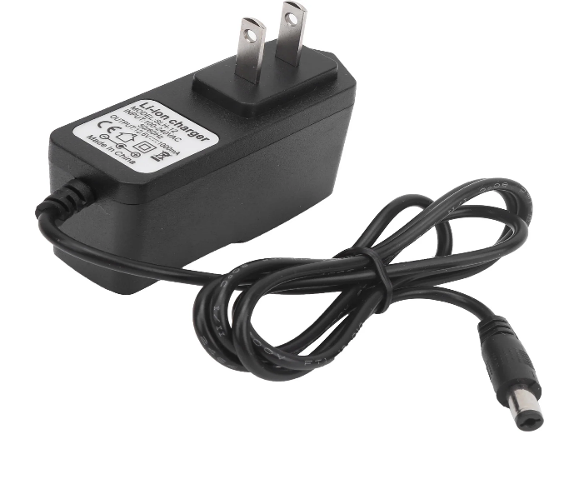
Hardware Components that are used:
Motor
Rechargeable Battery
Swtich
Trolly
charger

Slide 10
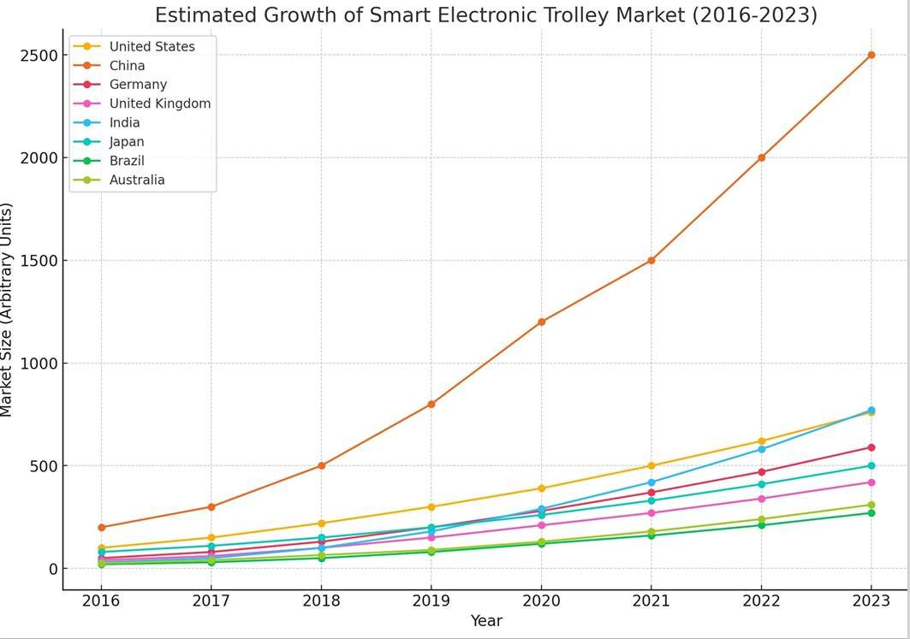
Data and Analysis
Introduction Background Methodology Data and Analysis Conclusions
Data and anaylsis shows the usage of smart electronic trolley in all over world.
As we can see china is leading the first postion in using smart electronic trolley.
Gradually smart electronic trolley usage is increased in India and united states.
Compare to china all other countries are still backing up in usage of smart electronic trolley in market.
•
10

Slide 11
Introduction
Background
Methodology
Data and Analysis
Conclusions
Market Growth
The adoption of smart electronic trolleys has grown in recent years, especially in tech-forward markets like China, the United States, Europe, and Japan. This growth is driven by increasing consumer demand for seamless shopping experiences and advancements in retail technology.
While still emerging, the market for smart trolleys is expected to expand as more retailers adopt digital transformation strategies and consumers become accustomed to digital, efficient shopping experiences.
11

Slide 12
Introduction Background
Conclusion
Methodology
Data and Analysis
Conclusions
Summary
The Smart Electronic Goods Carrying Trolley project aims to design and develop an efficient, reliable, and safe transportation system for electronic goods.
The Smart Electronic Goods Carrying Trolley project has the potential to revolutionize the transportation of electronic goods, ensuring efficiency,
safety, and reliability.
The Smart Electronic Goods Carrying Trolley project successfully demonstrates the integration of cutting-edge technologies to create an efficient, reliable, and safe transportation system.
12

Slide 13
Introduction
Background
Methodology
Data and Analysis
Conclusions
Future scope
Autonomous Navigation: Trolleys equipped with AI, sensors, and GPS for self-navigation.
Robotics Integration: Robotic arms or grippers for efficient loading/unloading.
IoT Connectivity: Real-time monitoring, tracking, and control through mobile apps.
Lightweight Materials: Reduced energy consumption and increased efficiency.
Healthcare: Efficient transportation of medical supplies and equipment.
Airports and Logistics: Automated baggage handling
Manufacturing: Internal transportation of goods and materials.
13

Slide 14
Thank You
14

Slide 15
References
https://www.irjmets.com/uploadedfiles/paper//issue_4_april_2023/35695/final/fin_irjmets1681586511. pdf
https://www.scribd.com/document/515586886/SMART-TROLLEY-PROJECT-IN-INDIA
https://www.ijraset.com/research-paper/smart-trolley-system.
Rachana Doshi, Amrita Sutar, Sonali Aher, Sanvida Dalvi."RFID Based Smart Trolley for Automatic Billing System," Global Journal of Advanced Engineering Technologies, Volume 5, Issue 4- 2016.
Mr.P.Chandrasekar, Ms.T.Sangeetha, "Smart Shopping Cart with Automatic Central Billing System through RFID and ZIGBEE", IEEE twelfth International Conference, 2014.
Zeeshan Ali, Reena Sonkusare, "RFID Based Smart Shopping and Billing", International Journal of Advanced Research in Computer and Communication Engineering Vol. 2, Issue 12, December 2013.
15

Slide 16

Smart electronic books carrying trolley

